Slide 1
Assignment Part III
Name: Sean Hartnett
Student No.: C12425762
Case Study: Nursing Home
Group 11

Slide 2
Inner Join
An inner join joins all rows from both tables that match the join predicate into a new table
It gives the intersection of the tables
The format for an inner join:
SELECT * FROM table1 JOIN table2
ON table1.column = table2.column;

Slide 3
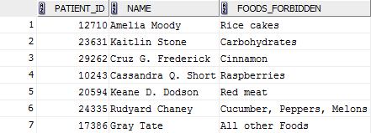
Example of Inner Join
Query:
Result:

Slide 4
Outer Join
An outer join gives the union of tables A and B
It will return all the rows in each table
It will display nulls if there are no values in a column
The format of an outer join:
SELECT * FROM table1 FULL OUTER JOIN
table 2 ON table1.column = table2.column;

Slide 5
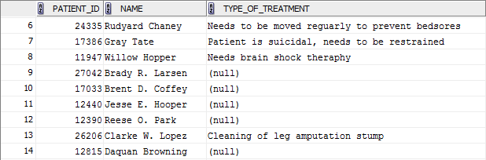
Example of Outer Join
Query:
Result:

Slide 6
Sub Query
A sub query is a query nested inside another SQL query
A sub query can be nested inside a SELECT, INSERT, UPDATE, or DELETE statement
You can have multiple sub queries in one statement
Example Format:
SELECT * FROM table1 WHERE coulumn1 IN (SELECT column1 FROM table1 WHERE column2 > 1000);

Slide 7
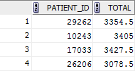
Example 1 of Sub Query
Query:
Result:

Slide 8
Example 2 of Sub Query
Query:
Result:

Slide 9
The End

